Slide 2
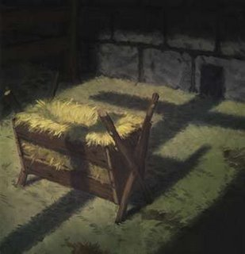

Slide 3
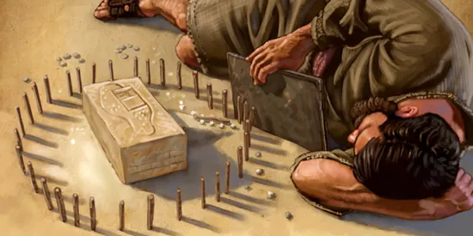

Slide 4
This will be a sign
to the people of Israel

Slide 5
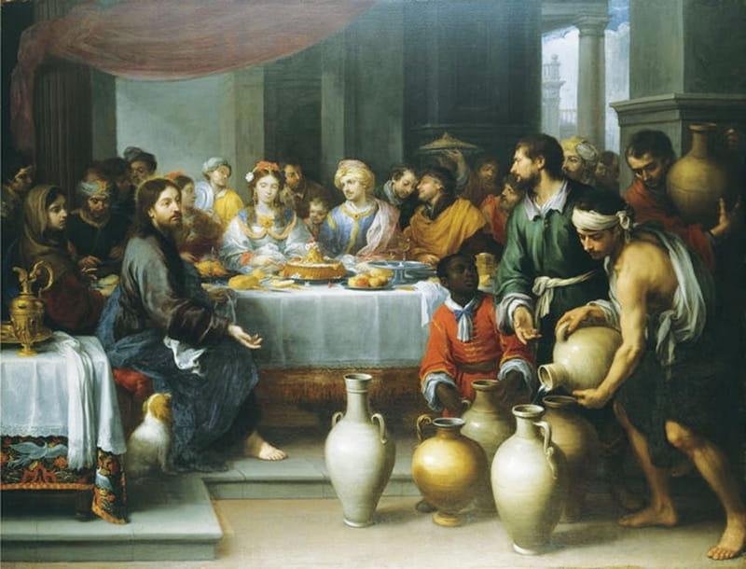

Slide 6
What Jesus did here in Cana of Galilee was the first of the signs through which he revealed his glory; and his disciples believed in him.

Slide 7
This will be a sign
to the people of Israel
-
What Jesus did . . . was the first of the signs through which he revealed his glory;

Slide 8
There are seven signs in Ezekiel:
Ezekiel sums these up:
chapter 12:11 Say to them, ‘I am a sign to you.’ “As I have done, so it will be done to them . . . Then they will know that I am the Lord.”

Slide 9
There are seven signs in John:
John 20:30,31 - Jesus performed many other signs in the presence of his disciples, which are not recorded in this book. But these are written that you may believe that Jesus is the Messiah, the Son of God, and that by believing you may have life in his name.

Slide 10
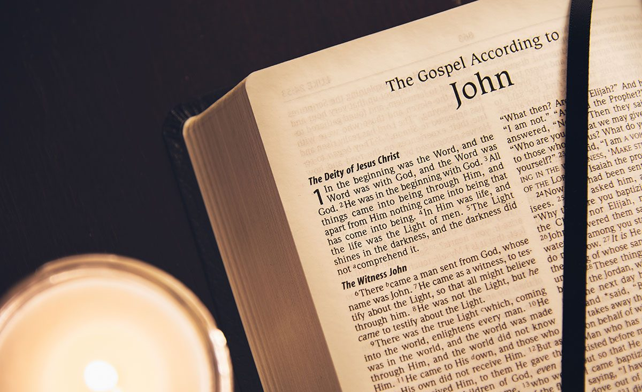

Slide 11
5 I have assigned you the same number of days as the years of their sin. So for 390 days you will bear the sin of the people of Israel.
6 “After you have finished this, lie down again, this time on your right side, and bear the sin of the people of Judah. I have assigned you 40 days, a day for each year.

Slide 12
Exodus 12:40-42
Now the length of time the Israelite people lived in Egypt was 430 years. At the end of the 430 years, to the very day, all the Lord’s divisions left Egypt. Because the Lord kept vigil that night to bring them
out of Egypt, on this night all the
Israelites are to keep vigil to honor the Lord for the generations to come.

Slide 13
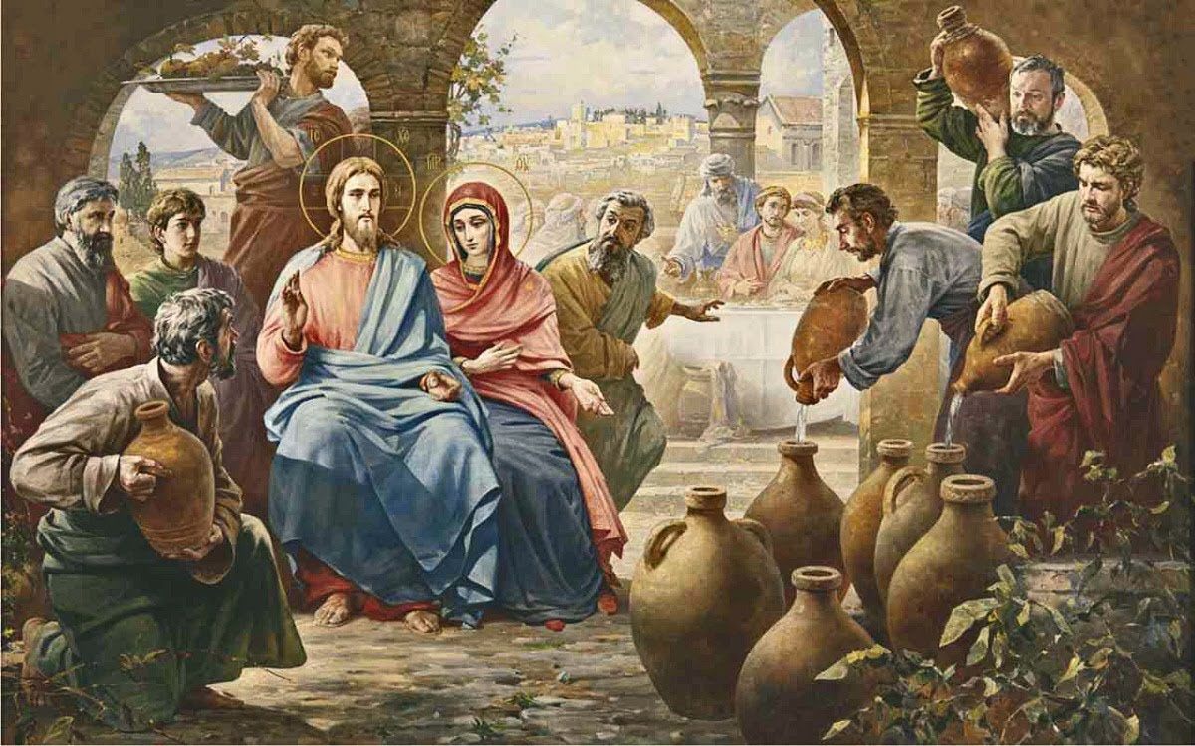

Slide 14
6 Nearby stood six stone water jars, the kind used by the Jews for ceremonial washing, each holding from twenty to thirty gallons.
7 Jesus said to the servants, “Fill the jars with water”; so they filled them to the brim.
8 Then he told them, “Now draw some out and take it to the master of the banquet.”
They did so, 9 and the master of the banquet tasted the water that had been turned into wine.

Slide 15
