Slide 2
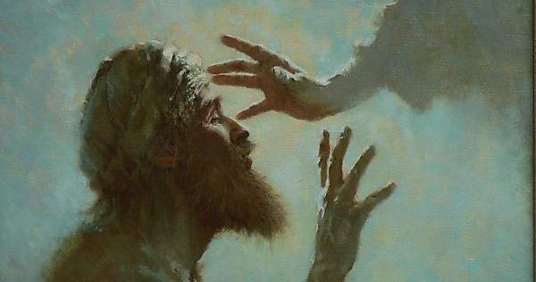

Slide 3
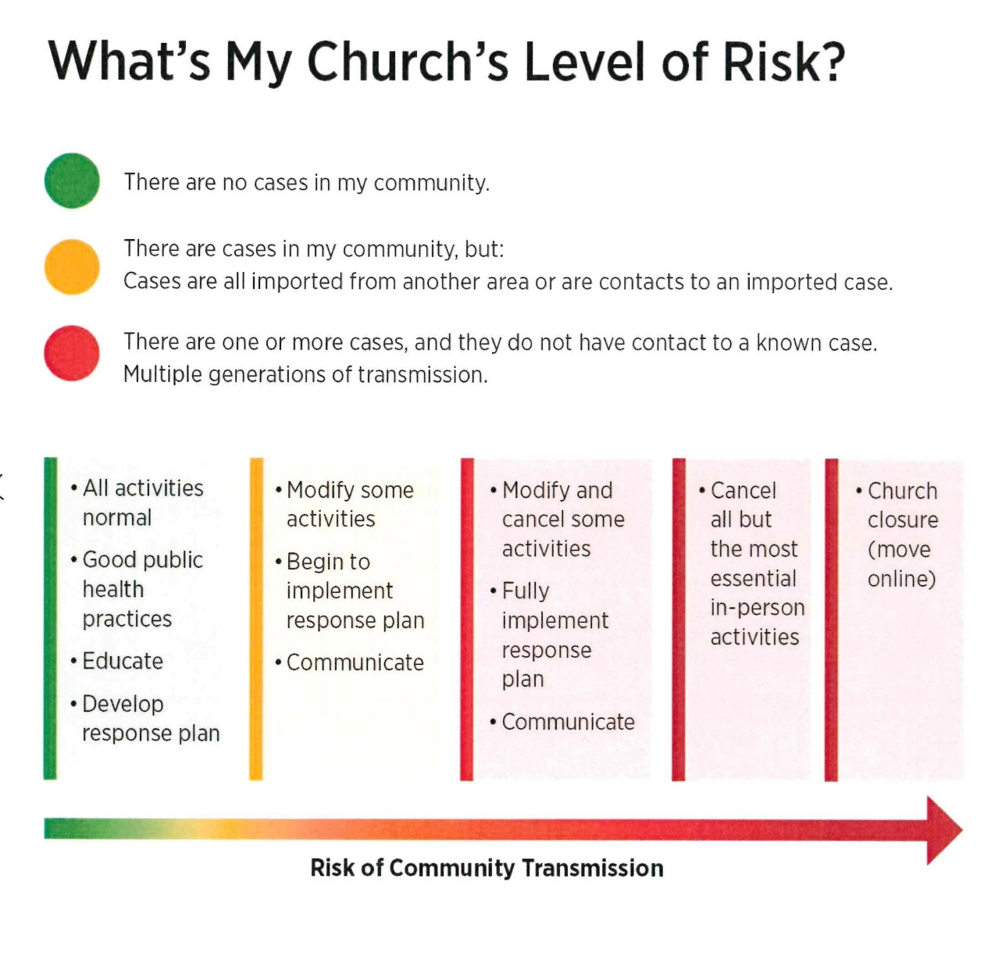
Lombard CRC
Community right now:

Slide 4
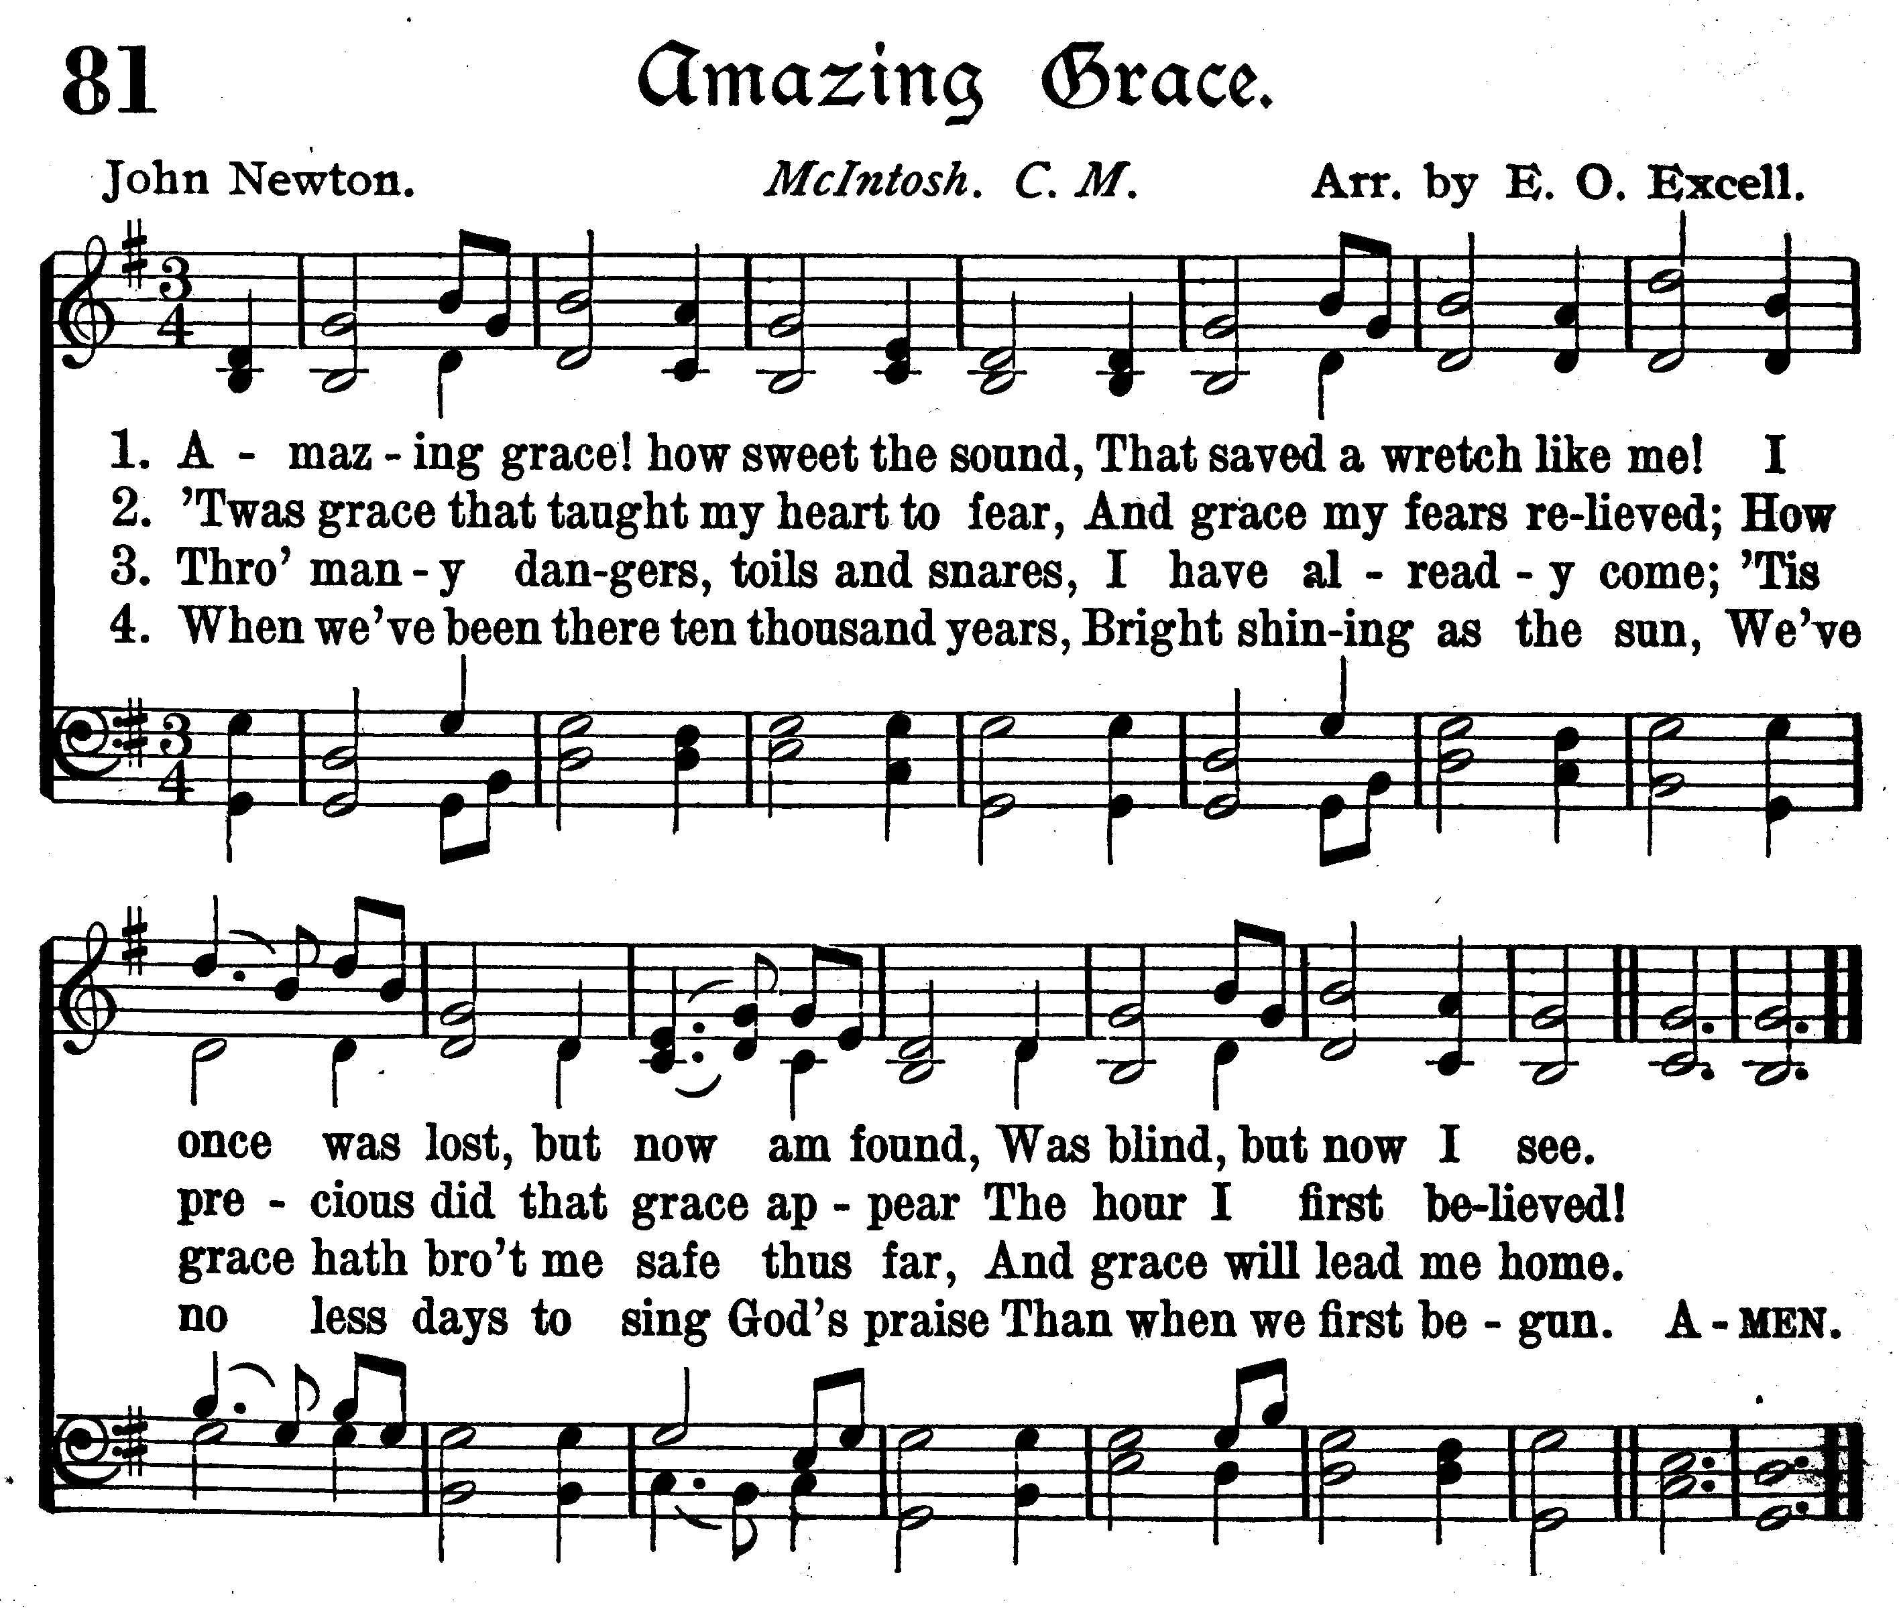

Slide 5
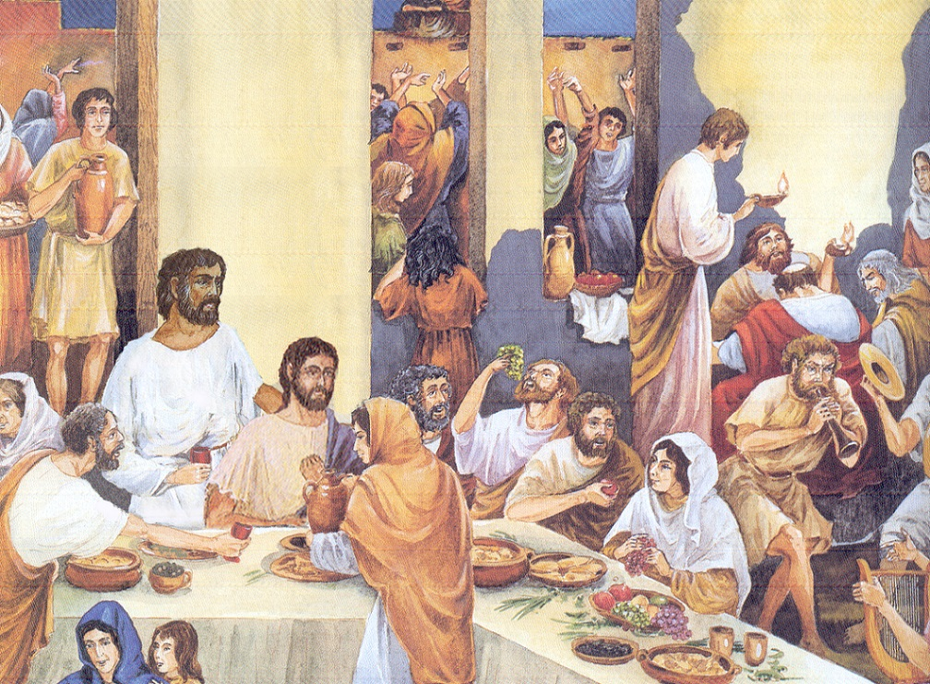

Slide 6
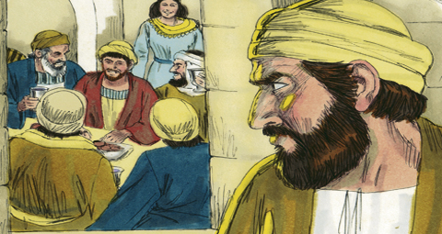

Slide 7
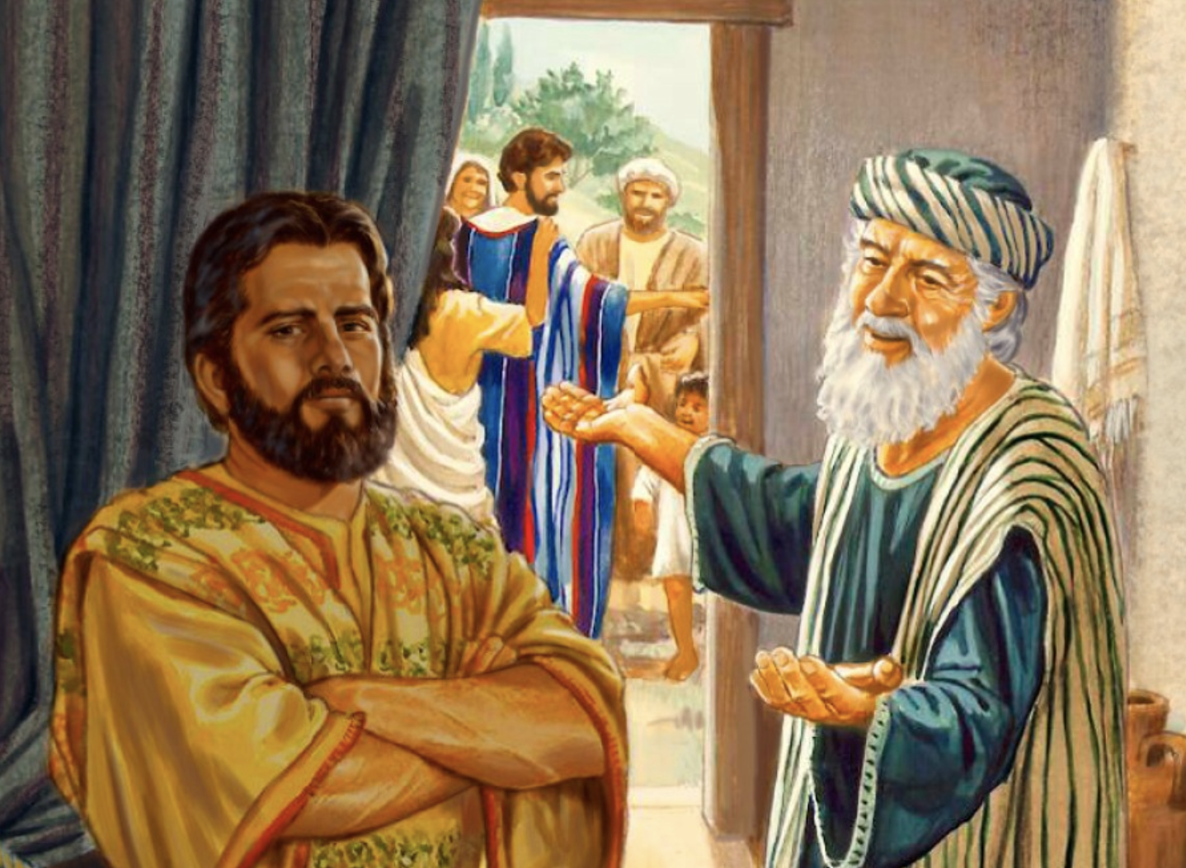

Slide 8
No one is too bad for God.
No one is too good for God.
Each of us is lost needing to be found.
Where do I feel lost right now?
There I will find Jesus reaching out to me.

Slide 9
We had to celebrate and be glad!

Slide 10
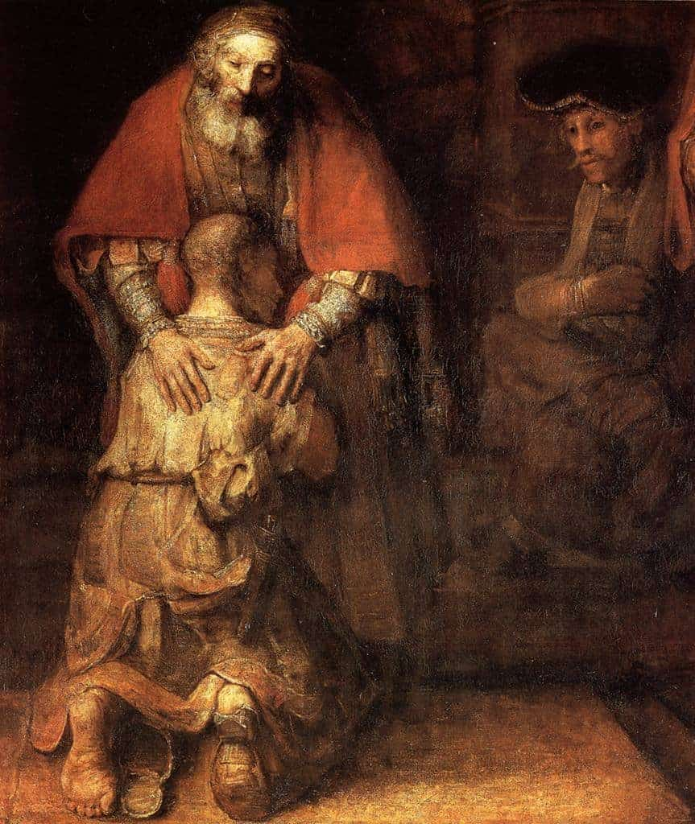

Slide 11
Let’s have a feast and celebrate. This son of mine was dead and is alive again
He was lost and is found.’

Slide 12
‘If you want to know who you are
in the Bible story, you are the sinner.
If the story has more than one sinner,
you are both of them.’

Slide 13
“Why pay so much attention to the sons when it is the father who is in the center and when it is the father with whom I am to identify?
Why talk so much about being like the sons when the real question is:
are you interested in being like the father?"

Slide 14
We experience grace from the Lord
most clearly when we act graciously.

Slide 15
The story reveals the character of God:
the Father finds the lost.
The story reveals the commitment of Christ:
he will not lose you.
The story invites our confession:
I am lost and am only really found by the Lord.
The story celebrates our call:
to look for the lost . . .

